Slide 1


Cluster Analysis of Twitter Data
Under the esteemed Supervision
of
Dr. Rupam Bhattacharya
(Faculty, Department of Computer Science and Technology, IIIT Bhagalpur)

Slide 2
Table of Contents
Introduction
1
What is Clustering Algorithm
2
Project Initialization
3
Preprocessing of Tweets
4
Tweets Classification
5
Applying Clustering Algorithm
6
Speaker: Naveen

Slide 3
01
Introduction

Slide 4

Introduction
Nowadays, people from all around the world use social media sites to share information. Twitter for example is a platform in which users send, read posts known as `tweets' and interact with different communities. Users share their daily lives, post their opinions on everything such as brands and places. Companies can benefit from this massive platform by collecting data related to opinions on them.
The aim of this paper is to present a model that can perform analysis of real data collected from Twitter. Data in Twitter is highly unstructured which makes it difficult to analyze.

Slide 5

Real World Use Case
Each tweet extracted classified into four categories that is “social”, “health”, “culture”, “economic”. Data was collected from my twitter Account and it is a developer account and Different machine learning algorithms were used.
And tests by our self by analysing that this tweet is related with which Category

Slide 6
02
Setting Up Project
( Building Block )

Slide 7
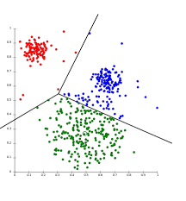
Building Block : Clustering Algorithm
Clustering algorithms take the data and using some sort of similarity metrics, they form these groups – later these groups can be used in various business processes like information retrieval, pattern recognition, image processing, data compression, bioinformatics etc. In the Machine Learning process for Clustering, as mentioned above, a distance-based similarity metric plays a pivotal role in deciding the clustering.
:

Slide 8
Building Block : K-Means Clustering Algorithm
It is an iterative algorithm that divides the unlabeled dataset into k different clusters in such a way that each dataset belongs to only one group that has similar properties.
It allows us to cluster the data into different groups and a convenient way to discover the categories of groups in the unlabeled dataset on its own without the need for any training.
:

Slide 9
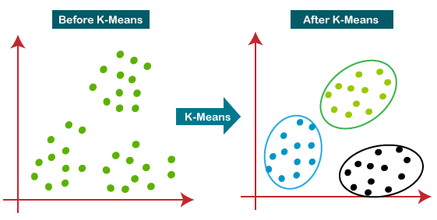
Building Block : K-Means Clustering Algorithm
:

Slide 10
d
03
Project Initialization

Slide 11
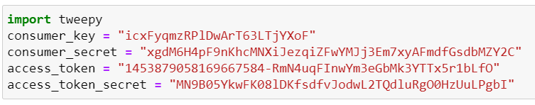
Prerequisite
Twitter Developer Account
The Twitter developer portal contains a set of self-serve tools that developers can use to manage their access to the Twitter API and Twitter Ads API.
Create and manage your Twitter Projects and Apps (and the authentication keys and tokens that they provide).

Slide 12
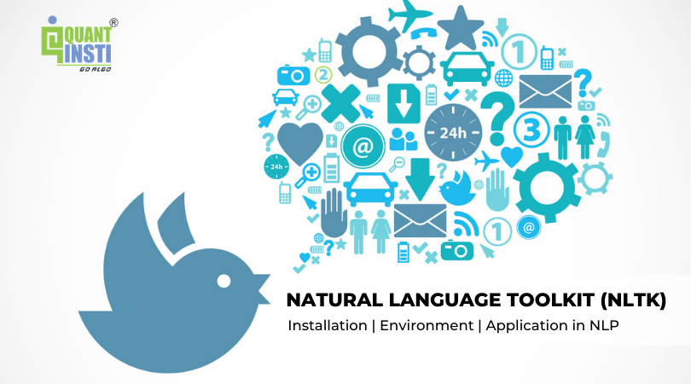
Import Relevant Libraries
Tweepy: gives you a very convenient way to access the Twitter API
nltk: NLTK, or Natural Language Toolkit, is a Python package that you can use for NLP.
Pandas Visualization: easy to use interface, built on Matplotlib
Seaborn: high-level interface, great default styles
Speaker: Naveen

Slide 13
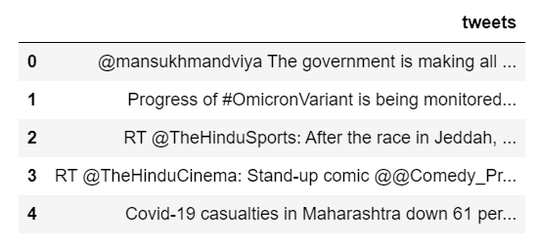
Tweet Dataset
The data used is scraped from twitter using Tweepy, a python library for accessing the Twitter API. It has 200 tweets
Speaker: Naveen

Slide 14
d
04
Preprocessing of Tweets

Slide 15
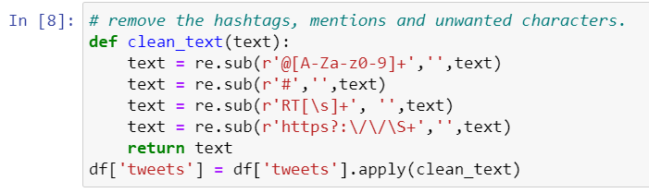
Cleaning tweets
Tweets contains unnecessary objects like hashtags, mentions, links and punctuation that can affect the performance of an algorithm thus they have to be rid off. All the texts are converted to lower case to avoid algorithms interpreting same words with different cases as different.

Slide 16
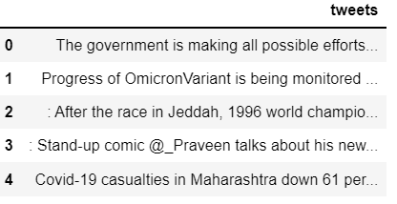
Cleaning tweets
Before Cleaning
After Cleaning

Slide 17
d
05
Tweets Classification

Slide 18
Tweets Classification
This approach uses the technique of creating a set of words that can be confidently classified as belonging to a particular category for each of the 4 classes. (Economic, Social, Cultural and Health)
The tweets are each compared with the 4 sets and assigned a similarity score. There are 2 main techniques popular for computing similarity score between documents:
Cosine Similarity
Jaccard Similarity

Slide 19
Tweets Classification
Cosine similarity: Cosine similarity is a metric used to measure how similar documents are irrespective of their size. Mathematically, it measures the cosine of the angle between two vectors projected in a multi-dimensional space. This would involve creating word vectors for the set of words and all the tweets then performing the cosine similarity.
Jaccard similarity: Jaccard similarity or intersection over union is defined as size of intersection divided by size of union of two sets.
Jaccard similarity takes only a unique set of words for each sentence or document while cosine similarity takes total length of the vectors. Jaccard similarity is good for cases where duplication does not matter, cosine similarity is good for cases where duplication matters.

Slide 20
Creating Sets of Related Words
As we are trying to classify our tweets into 4 category ie. Social, health, economy and culture then we simply search the words that are relating with these
And named as
Social Related Words
Culture Related Words
Health Related Words
Economy Related Words

Slide 21
d
06
Applying clustering algorithm

Slide 22
Jaccard Similarity Scores
The Jaccard index, also known as the Jaccard similarity coefficient, is a statistic used for gauging the similarity and diversity of sample sets. It was developed by Paul Jaccard, originally giving the French name coefficient de communauté, and independently formulated again by T. Tanimoto. Thus, the Tanimoto index or Tanimoto coefficient are also used in some fields. However, they are identical in generally taking the ratio of Intersection over Union.
We wish to create a data frame containing the total number of tweets per category per person. A 4D data frame with the index column populated with users, and 3 other columns containing the total number of the user’s tweets under social, cultural, health and economic classes.

Slide 23
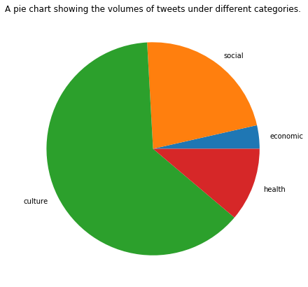
Volume of Tweets under different category
Below is a pie chart to show the tweets volumes in the different categories:
culture has the largest percentage. This could be as a result of the current pandemic that everyone is talking about.

Slide 24
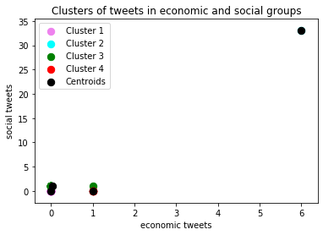
Applying K-Mean Clustering Algorithm
After Applying K-Mean clustering algorithm with k=4
We have successfully got 4 clusters of our tweets

Slide 25
Team Members
Group 2
1 | 180101033 | Partha Pratim Deori | IIIT Bhagalpur | CSE
2 | 180101036 | Rahul Ranjan | IIIT Bhagalpur | CSE
3 | 180101049 | Yashvant Singh Yadav | IIIT Bhagalpur | CSE

Slide 26

Let’s get solving.
Thank You

